Slide 1
Tremor Detection with Leap Motion

Slide 2
The Team
Joshua Stopper
Team Leader, Programmer, Client Contact
Daniel Corsaletti
Meeting Documenter, Team Support, Lead Tester
Shengwei LI
Lead Documenter
Minh Duc Nguyen
Support Programmer
Tran Xuong Tran
Support Documenter

Slide 3
The Client
Dr. Philip Michael
Surgeon for The Royal Victorian Eye & Ear Hospital

Slide 4
Problem Domain

Slide 5
The Solution
A web interface to record data and display results
Have a visual representation of a hand on screen to help with positioning

Slide 6
Solution Requirements
Hardware
Computer
Leap Motion Device
Software
Leap Motion Driver & Software
Google Chrome Browser
Our Developed Software

Slide 7
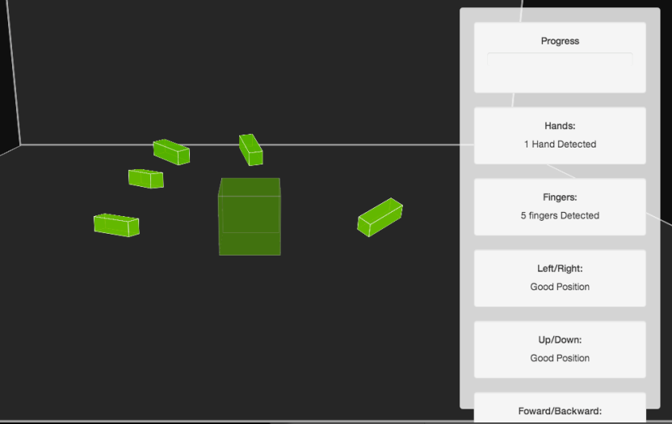
Solution Demonstration

Slide 8
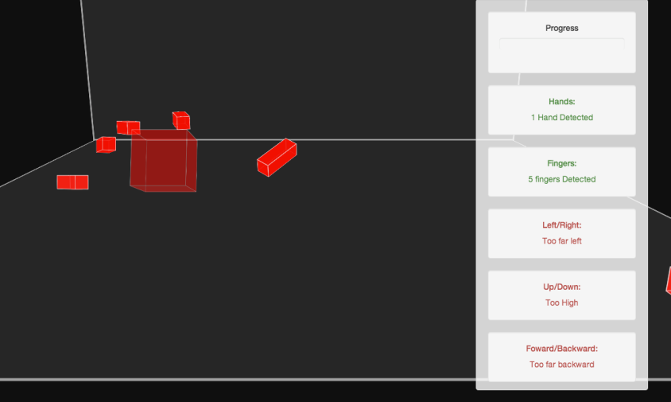
Solution Demonstration

Slide 9
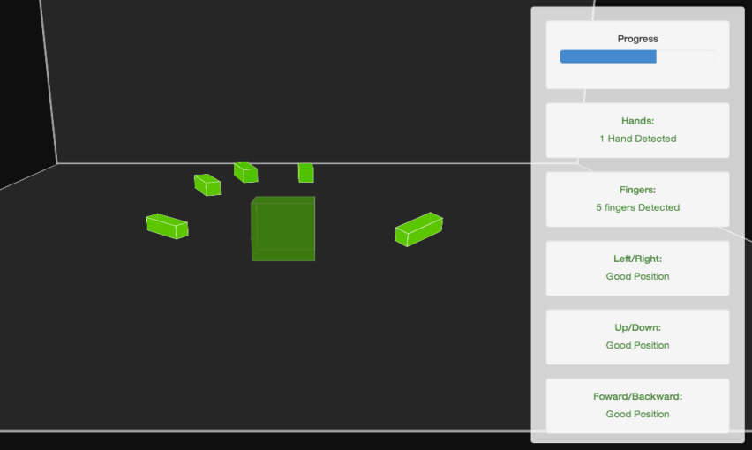
Solution Demonstration

Slide 10
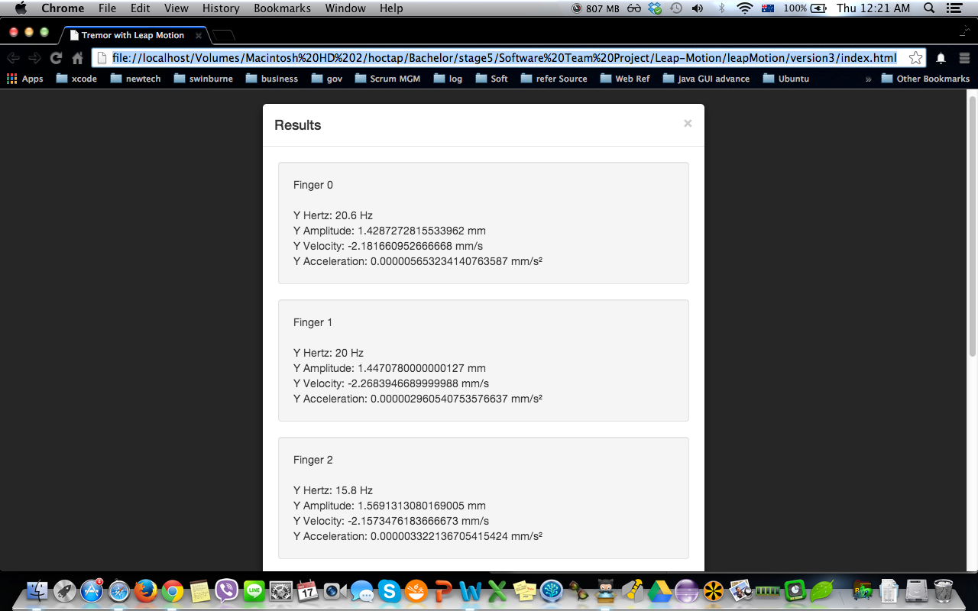
Solution Demonstration

Slide 11
Solution Benefits
Results returned immediately after the test has been conducted
Low entry costs to conduct analysis
Minimal time required for setup and analysis
Non-invasive to the individual

Slide 12
Future Improvements
Noise filtering to eliminate gross movements
Cross browser compatibility
Extended Functionality
Different tests for different types of tremor
Apply more testing activities:
Using Pencil to draw a straight line
Hold a stick and point to different points

Slide 13
What we learned
Work with clients
Project management
Teamwork
Software Version Control
Communication
Generating Idea & Solution

Slide 14
Thanks go to
Philip Michael
Mark Schier
Caslon Chua

